Slide 1
What’s New Tajo 0.11
Tajo Seoul Meetup 2015. 07
Hyunsik Choi, Gruter Inc.

Slide 2
Agenda
Tajo Overview
Milestones and 0.10 Features
What’s New in 0.11.
Notes:
This is an agenda of Today talk.
Firstly, I’ll give an overview of Tajo project.
Then, I’ll have a talk about the milestones and new features 0.10.
Finally, I’ll discuss upcoming release.

Slide 3
Tajo: A Big Data Warehouse System
Apache Top-level project
Distributed and scalable data warehouse system on various data sources (e.g, HDFS, S3, Hbase, …)
Low latency, and long running batch queries in a single system
Features
ANSI SQL compliance
Mature SQL features
Partitioned table support
Java/Python UDF support
JDBC driver and Java-based asynchronous API
Read/Write support of CSV, JSON, RCFile, SequenceFile, Parquet, ORC

Slide 4
Tajo Overall Architecture
Client
DBMS
JDBC
TSql
Web UI
CatalogStore
Submit a query
HCatalog
Master Server
TajoMaster
Manage metadata
Allocate a query
Slave Server
Slave Server
Slave Server
TajoWorker
TajoWorker
TajoWorker
QueryMaster
QueryMaster
QueryMaster
Local Query Engine
Local Query Engine
Local Query Engine
send tasks
& monitor
send tasks
& monitor
StorageManager
StorageManager
StorageManager
HDFS
HBase
HDFS
HBase
HDFS
HBase

Slide 5
Common Scenarios
Extraction, Transformation, Loading (ETL)
Interactive BI/analytics on web-scale big data
Data discovery/Exploratory analysis with R and existing SQL tools

Slide 6
Use Cases: Replacement of Commercial DW
Example: Biggest Telco Company in South Korea
Goal:
Replacement of slow ETL workloads on several TB datasets
Lots daily reports generation about users’ behaviors
Ad-hoc analysis on Terabytes data sets
Key Benefits of Tajo:
Simplification of DW ETL, OLAP, and Hadoop ETL into an unified system
Saved license over commercial DW
Much less cost, more data analysis within the same SLA

Slide 7
Use Cases: Data Discovery
Example: Music streaming service (26 million users)
Goal:
Analysis on purchase history for target marketing
Benefits:
Query interactivity on large data sets
Ability to use existing BI visualization tools

Slide 8
When Tajo is right choice?
You want an unified system for batch and interactive queries on Hadoop, Amazon S3, or Hbase.
You want a mixed use of Hadoop-based DW and RDBMS-based DW or want to replace existing RDBMS DW.
You want to use existing SQL tools on Hadoop DW

Slide 9
Milestones
2014.5
2014.10
2015.3
2015.7
0.8
0.9
0.10
0.11
More features & SQL compatibility
Stability &
Analytical function
Eco-system
expansion
More features
Python UDF
Nested Schema
Tablespace support
Basic Query federation
Better query scheduler

Slide 10
Selected Features in 0.10
Notes:
We did lots of things for 0.10 release.
Many things among them are related to eco system expansion.

Slide 11
Hbase Storage Support
You can use SQL to access Hbase tables.
Tajo supports Hbase storage
CREATE (EXTERNAL)/DROP/INSERT (OVERWRITE)/SELECT
Bulk Insertion through Direct HFile writing
CREATE TABLE hbase_t1 (key TEXT, col1 TEXT, col2 INT) USING hbase
WITH (
‘table’ = ‘t1’,
‘columns’ = ‘:key,cf1:col1,cf2:col2`,
‘hbase.zookeeper.quorum’ = ‘host1:2181,host2:2181’
)
Notes:
In 0.10, we integrated Hbase storage to Tajo.
Users can use SQL to access Hbase tables.
In tajo, You can do create table, insertion, and select queries including join and aggregation.
In particular, Tajo support bulk loading through direct hfile writing.

Slide 12
Better AWS support
Optimized for S3 and EMR environments
Fixed many bugs related to S3
EMR bootstrap supported in AWS Labs Github repo
A quick guide for Tajo on EMR
http://www.gruter.com/blog/setting-up-a-tajo-cluster-on-amazon-emr/
EMR bootstrap for Tajo on EMR
https://github.com/awslabs/emr-bootstrap-actions/tree/master/tajo
Notes:
One of the main improvements in 0.10 is better AWS support. We extensively tested Tajo in EMR.
Basically, Tajo accesses to S3 through S3 implementation of HDFS.
Because S3 is different from HDFS, we had to optimize Tajo’s S3 support and fixed many bugs for S3.
For example, S3 does not support move operation. We had to find a different way for temporary staging data of table writing.
While we were improving S3 support, we also made EMR bootstrap, which is a kind of script to launch Tajo on EMR service.
This work was committed to AWS lab repository. You can easily launch a Tajo cluster by using this script in EMR service.

Slide 13
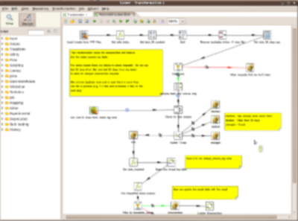
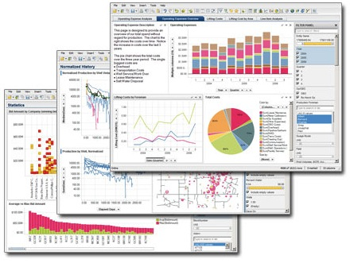
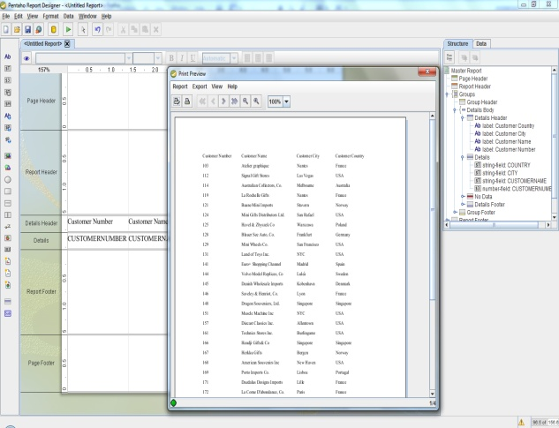
Better SQL tool support via thin JDBC
ETL Tools
BI Tools
Reporting tools
Tajo JDBC
Tajo Cluster
HDFS
HBase
S3
Swift
Notes:
We also refactored Tajo JDBC to be thin.
Unlike other systems, Tajo Thin JDBC driver does not require extra classpath.
And its compatibility is also very high.
You can use many JDBC-based SQL tools to access Tajo.
We tested the driver on Spotfire, Burst, and Pentaho.

Slide 14
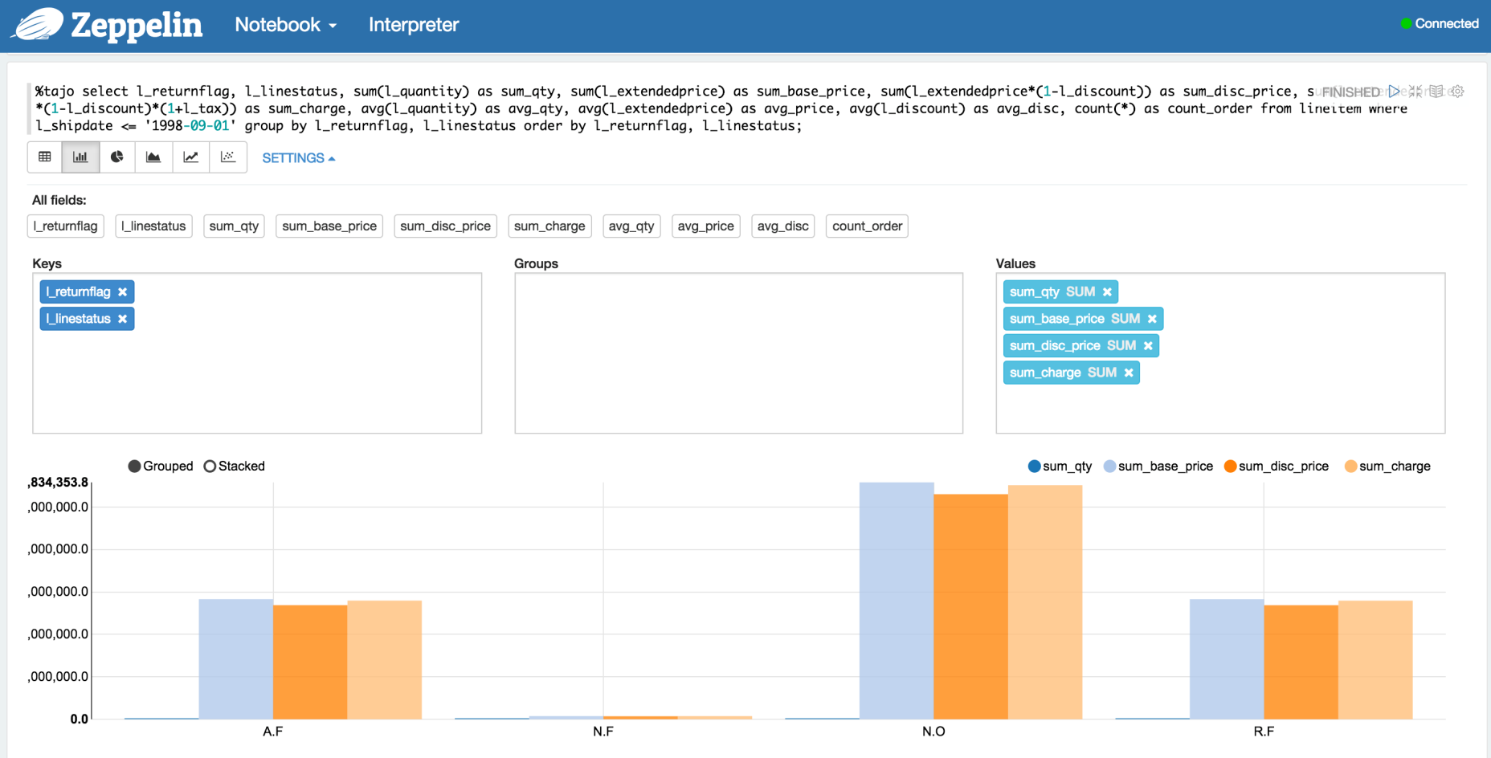
Zeppelin Integration
Notes:
We also integrated Tajo with Zeppelin. Zeppelin is the most promising opensource data science tool in hadoop ecosystem.
It allows users to access execution engines and visualize the result in a single platform without any context switching.
Tajo team also submitted the patch for the zeppelin integration to Zeppelin community.
So, you can just use zeppelin to access Tajo.

Slide 15
Improved Performance and Stability
Offheap sort operator for ORDER BY (TAJO-907)
Hash shuffle IO improvement (TAJO-374, TAJO-987)
Skewness handling of hash shuffle
Automatic parallel degree choice during runtime
Lots of query optimizer improvements
Add Master HA (TAJO-704)
More error-tolerant shuffle fetch (TAJO-789, TAJO-953)
Notes:
We also improved query performance and stability.
We introduced offheap sort to avoid gc overhead during large sort.
We also enhanced shuffle performance in many issues. Shuffle is essential distributed operation for join, and aggregation.
We also did many things for high availability.

Slide 16
What’s New in Tajo 0.11

Slide 17
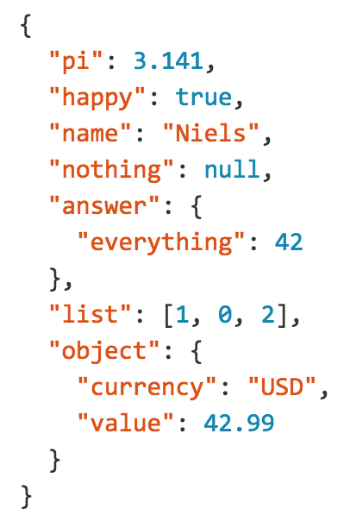
Nested data and JSON support
Nested data is becoming common
JSON, BSON, XML, Protocol Buffer, Avro, Parquet, …
Many web applications in common use JSON.
MongoDB by default uses JSON document
Many Hbase users also store JSON document in a cell.
Flattening causes lots of data/computation overhead.
Tajo 0.11 natively supports nested data types.

Slide 18
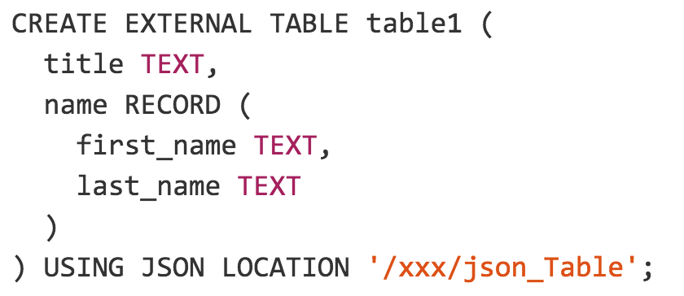
How to create a nested schema table
Use ‘RECORD’ keyword to define complex data type
Notes:
As you can see, Tajo provides RECORD keyword to describe complex nested data type.
You can use complex type for nested file formats like Parquet and Avro.
This is an example CREATE TABLE statement for such a JSON.
You can see an issue about schema on self-describing format.
Basically, current Tajo needs schema definition for each table.
You still need to define some schema even for self-describing format like Json.
But, strict schema definition does not make sense for JSON.
because schemaless is one of the main reasons why we use JSON.

Slide 19
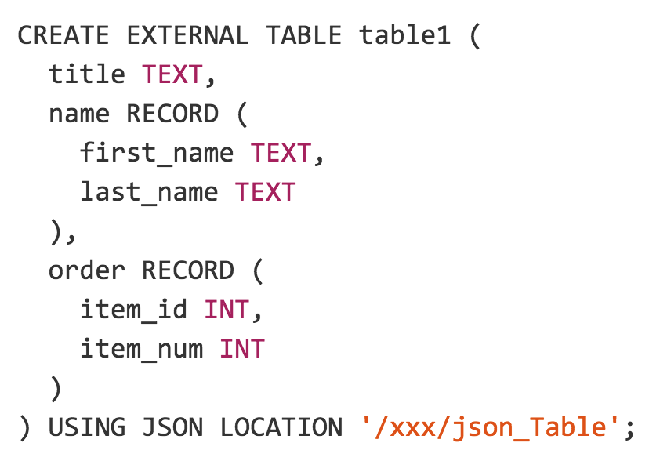
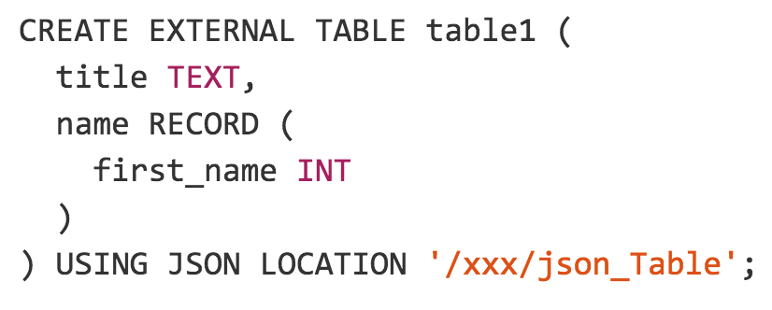
Loose schema for self-describing formats
You can handle schema evolving with ALTER ADD COLUMN!
Notes:
So, we introduced loose schema for self-describing formats.
With loose schema support, you just need to define only columns you want to project.
Because many file formats like Parquert, Avro, ORC are self-describing,
this feature is very important.
See the example, against this data set, you can use various schema definition like them.
If there is no value corresponding to the column definition, null value will be retrieved.
Later, we have a plan to support schema-on-read, which is
an way to guess or recognize the schema from self-describing format file.
After than, you can omit the schema definition.

Slide 20
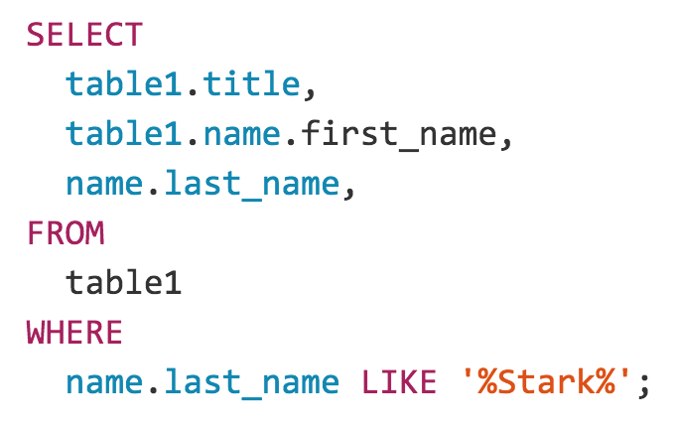
How to retrieve nested fields
SQL
Table Definition
Input Data
Notes:
How we retrieve nested fields?
You can use dot notation to access nested fields.
For example, this column expression let Tajo to access the nested field ‘first name’ under ‘name’.
Nested schema support is still evolving is Tajo project.
We will also add more feature about it.

Slide 21
Query federation and Tablespace support
Query support across multiple data sources
You can perform join or union among tables on different systems.
Benefits:
Data offload from RDBMS to Hadoop vice versa
A mixed use of existing RDBMS and Hadoop.
Access to NoSQL and various storages through SQL
An unified interface for SQL tools
Apache Tajo
HDFS
NoSQL
S3
Swift
Notes:
One of the main feature 0.11 is query federation and tablespace support.
You can perform a single query across multiple data sources.
This feature has various benefits.
You can offload data stored in RDBMS to Hadoop.
It is very helpful to use an unified SQL interface to access various storages.

Slide 22
Datasets stored in Various Formats/Storages
ORC
Data Formats
Sequence File
Protocol Buffer
RCFile
Storage Types
Notes:
In 0.11, you can use these data formats and storage types.

Slide 23
Tablespace
Tablespace
Registered storage space
A table space is identified by an unique URI
Configuration and Policy shared in all tables in the same tablespace
It allows users to reuse registered storages and their configuration.

Slide 24
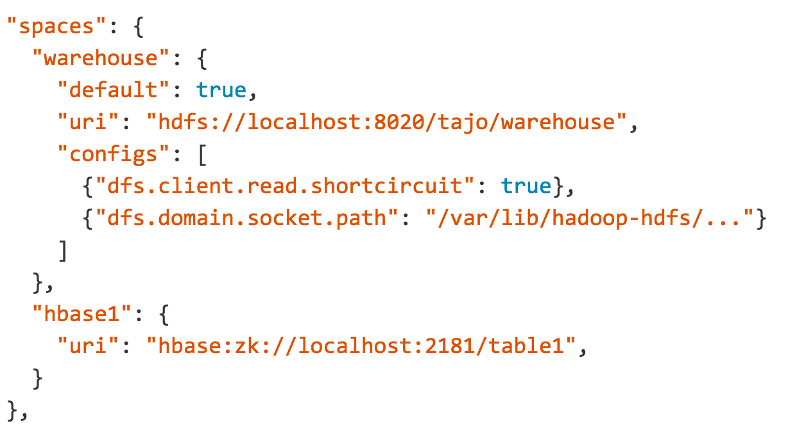
Tablespace Configuration
Tablespace name
Tablespace URI
Notes:
This example shows an tablespace configuration.
This configurare sets two tablespaces named warehouse and hbase1.
After you made such a configuration,

Slide 25
Create Table on a specified Tablespace
> CREATE TABLE uptodate (key TEXT, …) TABLESPACE hbase1;
> CREATE TABLE archive (l_orderkey bigint, …) TABLESPACE warehouse USING text WITH (‘text.delimiter’ = ‘|’);
Tablespace Name
Format name

Slide 26
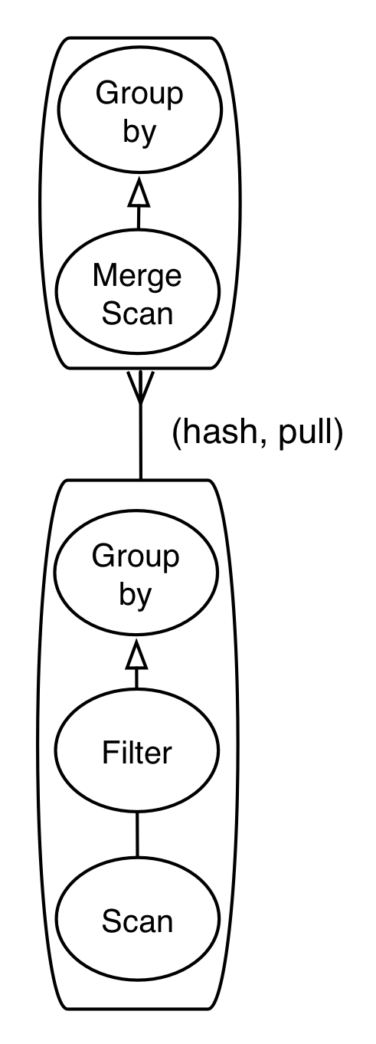
Operation Push Down
SELECT
X,
SUM(Y)
FROM
table1
WHERE
x > 100
GROUP BY
x
Filter, Projection or Groupby can be pushed down into
Underlying storages (like RDBMS, Hbase, Elasticsearch, …)
Underlying
Storage
Notes:
Of course, Tajo pushes down filter and projection into underlying storage.
We are also expecting that aggregation also can be pushed down into underlying storage like RDBMS.
This work is still working.

Slide 27
Current Status of Storages
Storages:
HDFS support
Amazon S3 and Openstack Swift
Hbase Scanner and Writer - HFile and Put Mode
JDBC-based Scanner and Writer (Working)
Auto meta data registration (working)
Kafka, Elastic Search (Patch Available)
Data Formats
Text, JSON, RCFile, SequenceFile, Avro, Parquet, and ORC (Patch Available)
Notes:
We also Hbase table write.
Tajo supports bulk load for hbase.
This approach is to write hfile directly and let hbase to load the hfile.
Also, Tajo support put mode. With put mode, you can instantly insert row into Hbase by using insert statement.
Kafka and Elastic search are already patch available.
ORC scanner is also patch available.
We have a plan to ORC scanning and writing to 0.11.

Slide 28
Python UDF
Python UDF and UDAF are supported in Tajo
http://tajo.apache.org/docs/devel/functions/python.html
@output_type('int4') def return_one(): return 1 @output_type('text') def helloworld(): return 'Hello, World’ @output_type('int4') def sum_py(a,b): return a+b
Notes:
Many data scientist have asked us to support python udf.
So, we add this feature to 0.11.
Tajo support UDF as well UDFA.

Slide 29
Improved Standalone Scheduler
Standalone FIFO scheduler
Before
only one running query at a time was allowed
After
multiple running queries are allowed at a time
resizable resource allocation of running queries
Future works after 0.11
Multiple queues support

Slide 30
Get Involved!
We are recruiting contributors!
General
http://tajo.apache.org
Getting Started
http://tajo.apache.org/docs/0.10.0/getting_started.html
Downloads
http://tajo.apache.org/downloads.html
Jira – Issue Tracker
https://issues.apache.org/jira/browse/TAJO
Join the mailing list
dev-subscribe@tajo.apache.org
issues-subscribe@tajo.apache.org

Slide 31
Q&A

